Slide 1
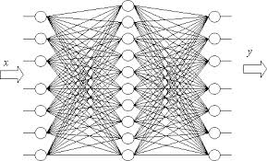
Kazan National Research Technical University named after A.N. Tupolev
German-Russian Institute of Advanced Technologies (GRIAT)
NEURAL NETWORKS
by D.Sc Igor Anikin

Slide 2
Brief contents
  The basic concepts of neural networks
    Artificial neural networks. Motivation and history.
    The structure of an artificial neuron.
    Activation functions.
    Basic paradigms of neural networks.
    Fundamentals of learning and training samples.
    Using neural networks in practice
  Single layer neural networks
    Rosenblatt's single layer perceptron.
    Training single layer neural networks.
    Associative memory.
  Multilayer perceptrons
    The structure of multilayer perceptrons
    Back propagation of error.
    Patterns recognition and time series forecasing.

Slide 3
  Self-organizing maps
    The principle of unsupervised learning.
    Kohonen self-organizing maps.
    Training Kohonen networks.
    Practical using of Kohonen networks
  Basic recurrent neural networks
    Neural networks with feedback.
    Hopfield neural network.
    Hamming neural network.
    Training Hopfield and Hamming neural networks.
    Practical using of Hopfield and Hamming neural networks.
  Applied Neural Networks
    Convolutional NN, LSTM, GAN…

Slide 4
Basic concepts of neural networks

Slide 5
Motivation of AI
Artificial intelligence (AI), is intelligence demonstrated by machines, in contrast to the natural intelligence displayed by humans and other animals.
Q: What does it mean to be intelligent?
There are problem categories that cannot be formulated as an algorithm. Without an algorithm a computer cannot do the same. Therefore the question is: How do we learn to explore such problems.
Some AI tools:
  Expert systems.
  Artificial neural networks.
  Uncertain reasoning (including fuzzy logic).
  NLP.
  etc

Slide 6
Types of learning
Knowledge is a familiarity, awareness, or understanding of someone or something, such as facts, information, descriptions, or skills, which is acquired through experience or education by perceiving, discovering, or learning.
Knowledge acquisition from expert (expert systems). Applicable if well-defined rules accessible with precise input data
Knowledge acquisition from data:
  Supervised learning – the system is supplied with a set of training examples consisting of inputs and corresponding outputs, and is required to discover the relation or mapping between them.
  Unsupervised learning – the system is supplied with a set of training examples consisting only of inputs. It is required to discover what appropriate outputs should be.

Slide 7
Motivation of artificial neural networks
Study of artificial neural networks is motivated by their similarity to successfully working biological systems, which consist of very simple but numerous nerve cells that work massively in parallel and have the capability to learn
The neural computer adapts itself during a training period, based on examples of similar problems even without a desired solution to each problem. After sufficient training the neural computer is able to relate the problem data to the solutions, inputs to outputs, and it is then able to offer a viable solution to a brand new problem.

Slide 8
Artificial Neural Networks
Self-organization and learning capability.
Have not be explicitly programmed.
Capability to generalize and associate data: after successful training a neural network can find reasonable solutions for similar problems of the same class that were not explicitly trained.
Fault tolerant against internal errors and noise, redundancy, and sharing of responsibilities.
Applicable if rules are unknown or complicated.
Memory is distributed and content addressable.
Disadvantages:
  ANN is a black box;
  It is difficult to recognize where is the fault

Slide 9
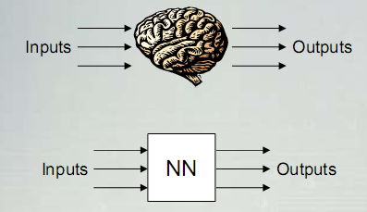
Artificial Neural Network
An extremely simplified model of the human’s brain
Transforms inputs into the best outputs (some neural networks are the universal function approximators).

Slide 10
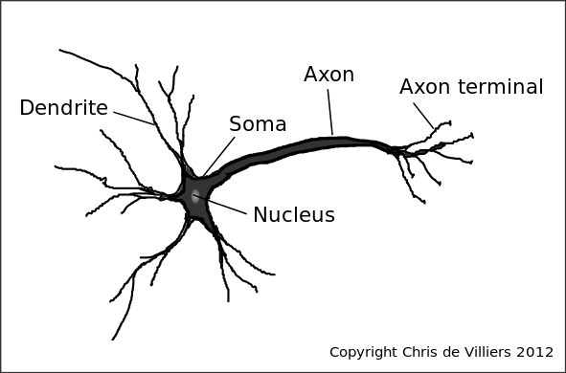
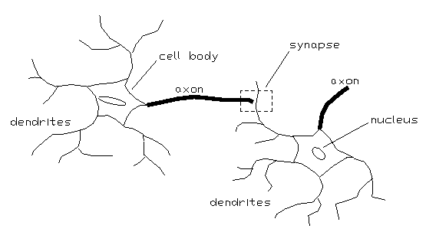
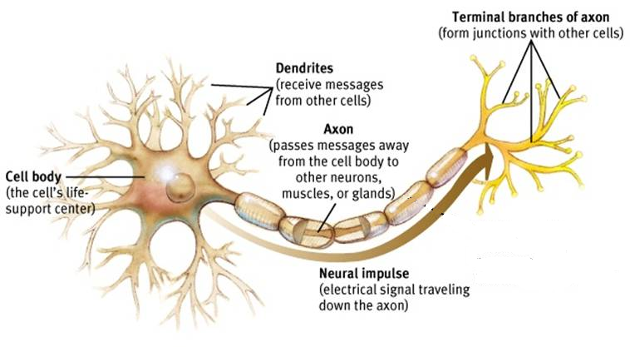
Biological neuron

Slide 11
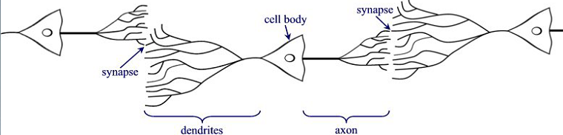
Biological neuron
Many “neurons” co-operate to perform the desired function
Basic elements:
  Axon
  Dendrite
  Synapse

Slide 12
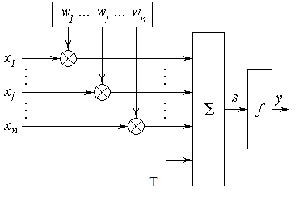
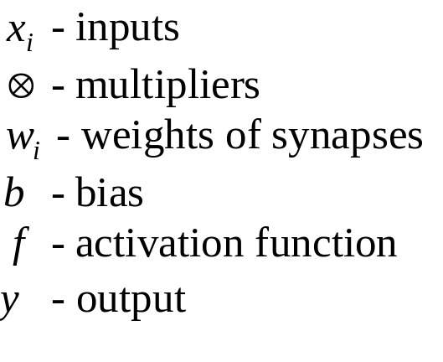
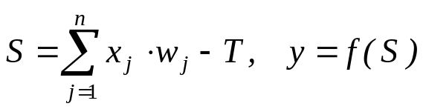
Artificial Neuron Structure
The output of a neuron is a function of the weighted sum of the inputs plus a bias

Slide 13
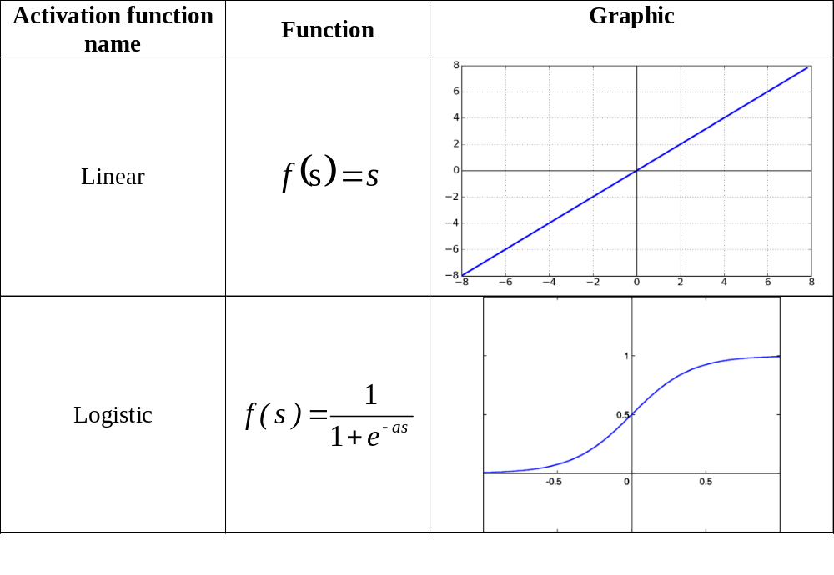
The most common activation functions

Slide 14
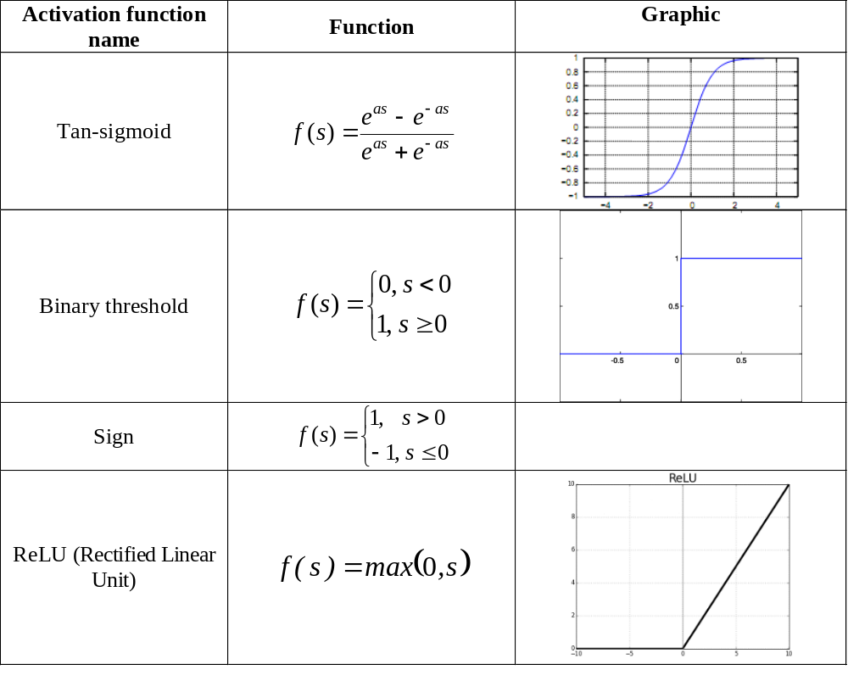

Slide 15
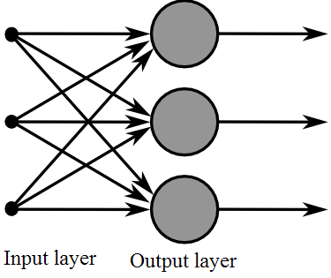
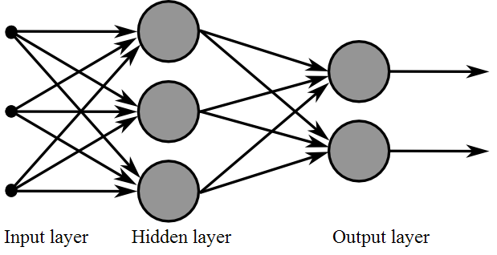
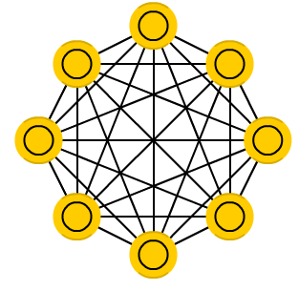
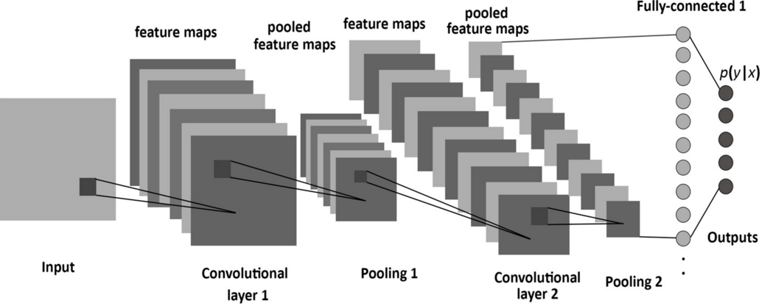
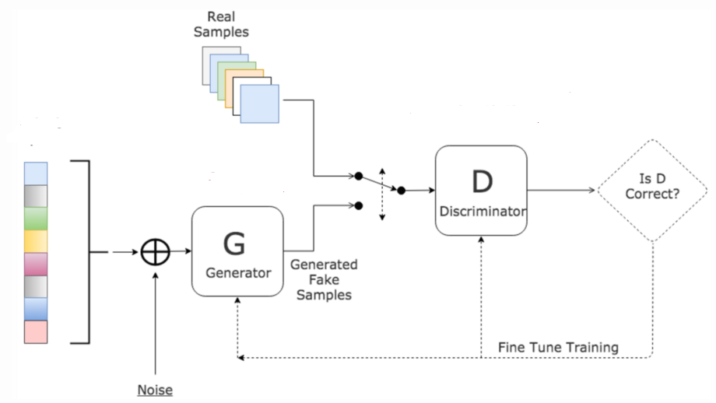
Some examples of ANN topologies
Single layer ANN
Multilayer ANN
Hopfield
Convolutional NN
Generative adversarial network

Slide 16
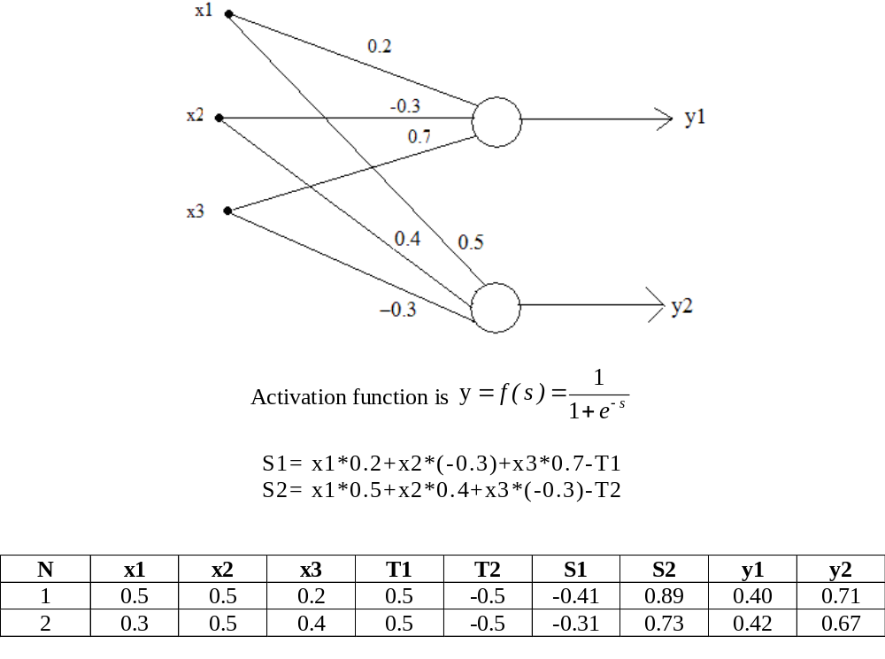
Calculations

Slide 17
History
1943. Warren McCulloch, Walter Pitts introduced model of neurological networks.
1949. Donald O. Hebb formulated the classical Hebbian rule.
1951. Marvin Minsky developed the neurocomputer which has already been capable to adjust its weights automatically.
1957-1958. Frank Rosenblatt, Charles Wightman and their coworkers developed the first successful neurocomputer, the Mark I perceptron.
1960. Bernard Widrow and Marcian E. Hoff introduced the ADALINE (ADAptive LInear NEuron), a fast and precise adaptive learning system.
1969. Marvin Minsky and Seymour Papert published a precise mathematical analysis of the perceptron to show that the perceptron model was not capable of representing many important problems.
1982. Teuvo Kohonen introduced Kohonen maps.
1985. John Hopfield introduced Hopfield nets.
1986. The backpropagation of error learning procedure as a generalization of the delta rule was developed and widely published (D. Rumelhart, G. Hinton, and R. Williams )

Slide 18
Fundamentals of learning and training samples
The weights in a neural network are the most important factor in determining its function.
A training set is a set of training patterns, which we use to train our neural net.
Training is the act of presenting the network with some sample data and modifying the weights to better approximate the desired function

Slide 19
Fundamentals of learning and training samples
There are two main types of training
  Supervised Training
    Supplies the neural network with inputs and the correct outputs (results).
    We can estimate a error vector for certain input.
    Response of the network to the inputs is measured. The weights are modified to reduce the difference between the actual and desired outputs
  Unsupervised Training
    The training set only consists of input patterns.
    The neural network adjusts its own weights so that similar inputs cause similar outputs. The network identifies the patterns and differences in the inputs without any external assistance

Slide 20
Fundamentals of learning and training samples
A training pattern is an input vector p with the components x₁, x₂, . . . , x_{n} whose desired output is known.
By entering the training pattern into the network we receive an output that can be compared with the desired output.
The set of training patterns is called P. It contains a finite number of ordered pairs (p, t) of training patterns with corresponding desired output t.

Slide 21
Fundamentals of learning and training samples
Teaching input. Let j be an output neuron. The teaching input t_{j} is the desired and correct value j should output after the input of a certain training pattern.
Analogously to the vector p the teaching inputs t₁, t₂, . . . , t_{n} of the neurons can also be combined into a vector t. This vector always refers to a specific training pattern p and contained in the set P of the training patterns.

Slide 22
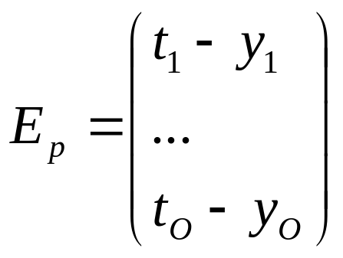
Fundamentals of learning and training samples
Error vector. For several output neurons Ω₁,Ω₂, . . . ,Ω_{O} the difference between output vector and teaching input under a training input p is referred to as error vector.

Slide 23
Fundamentals of learning
Let P be the set of training patters. During learning procedure we implement finite number of iterations or epochs.
Epoch – single presentation of the entire data to the neural network. Typically many epochs are required to train the neural network
Iteration - the process of providing the network with an single input and updating the network's weights

